Slide 1

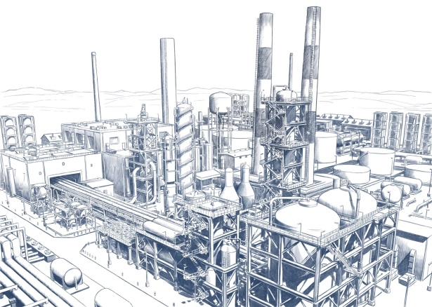
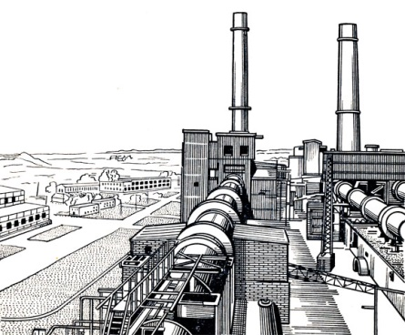

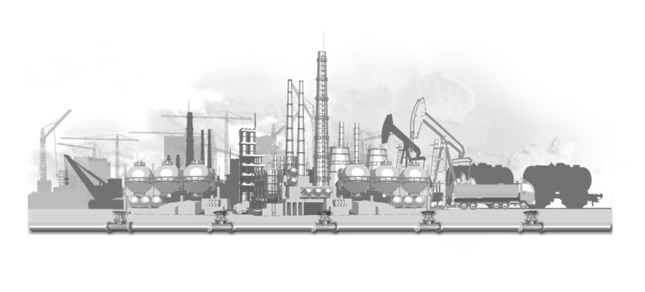
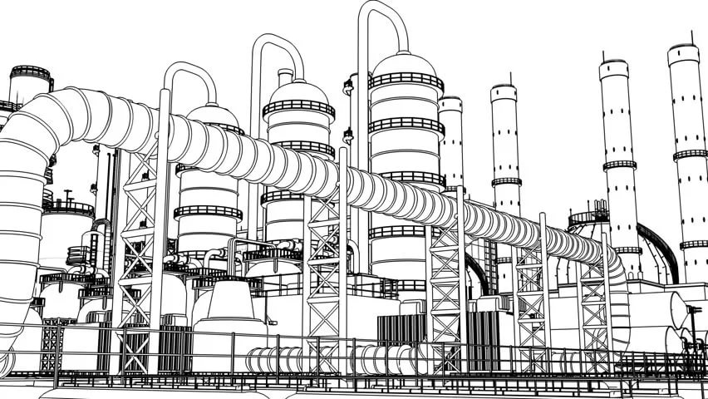
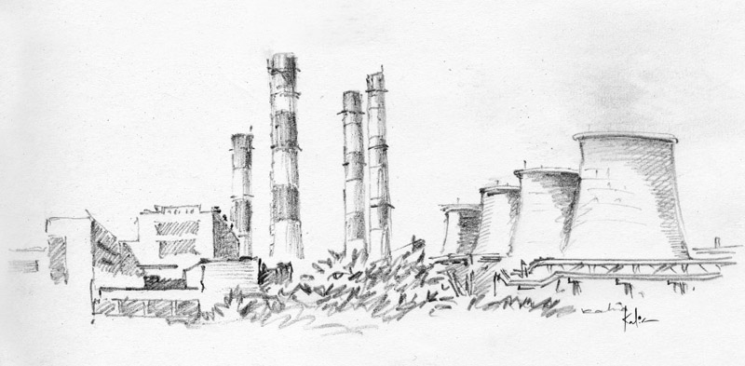
State Scientific Center FSUE
I.P. Bardin Central Research Institute for Ferrous Metallurgy
State Scientific Center FSUE I.P. Bardin Central Research Institute
for Ferrous Metallurgy: the Outcomes of 2018
General Director,
Ph.D
Viktor Semenov

Slide 2

Institute Activities
State industrial policy scientific support in metallurgy implemented by the Ministry of Industry and Trade of the Russian Federation
Fundamental and pilot researches to create a scientific basis for the development of new steels and alloys
Industrial production technologies development of steels and alloys (steel technologies)
New steels and alloys development, pilot samples research (new steels and alloys with improved characteristics or new properties)
Low-tonnage steel production, production of new steels and alloys pilot samples
Testing, standardization and certification of metal products, examination of steel technologies
Further training and retraining of human resources in metallurgy

Slide 3
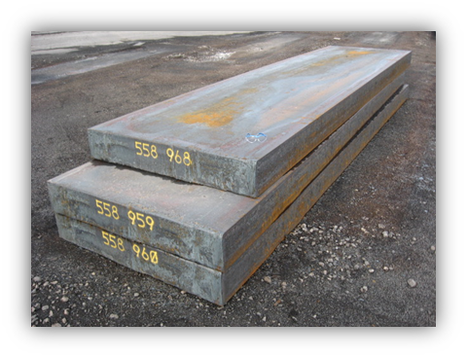
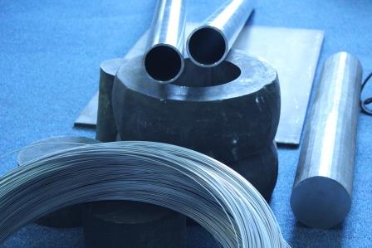
ЦНИИчермет им. И.П. Бардина
Institute Activities
  Metallurgical equipment development
  Technologies development of steels and alloys treatment (cutting, shaping, welding, additive technologies, modifying treatment and coating)
  Engineering and technological audit within the projects of capital construction, reconstruction and technical re-equipment of metallurgical industries

Slide 4
Human resources
Human resources | Quantity, ppl.
Total amount | 422
Academic staff | 257
Young professionals below the age of 39 years | 70
Academic staff
Doctors of Science | 22
Doctors of Philosophy | 71
Profesors | 11
Over 170 employees of the Institute have been granted high ranks of the Soviet Union and the Russian Federation, among them Lenin, State and Government Awards.
Over the past 5 years there were obtained 74 patents.

Slide 5
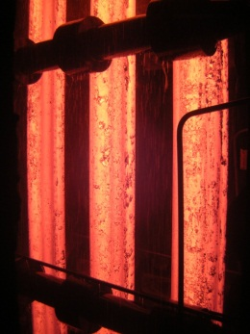
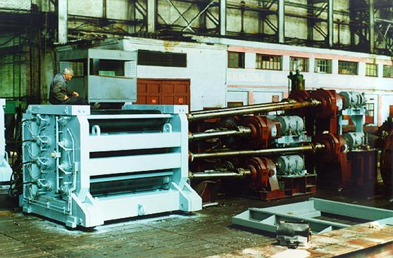
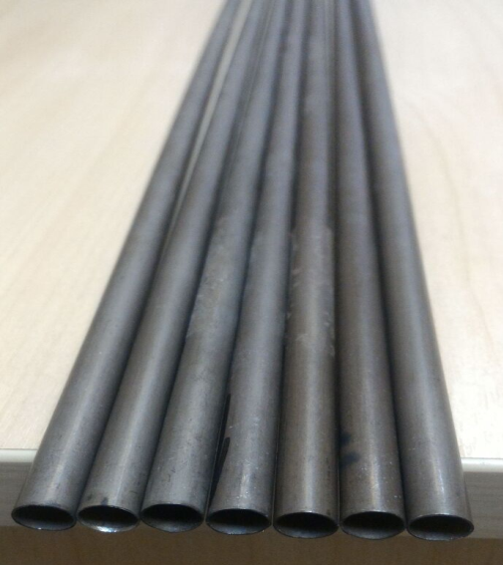
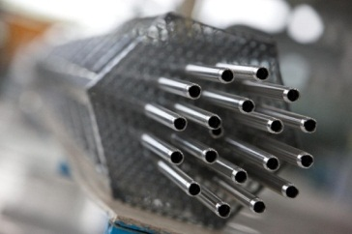
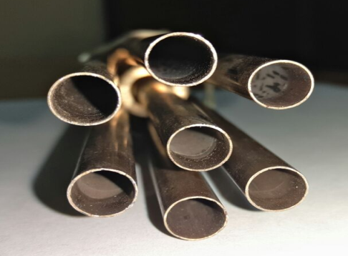
Development Examples
Development of technologies and equipment for metal industries
Metal rolling
Enterprises of the Ministry of Industry and Trade of the Russian Federation
Extra-thin seamless cold-rolled pipes
Long pipes (over 30 m)
Enterprises of Rosatom

Slide 6
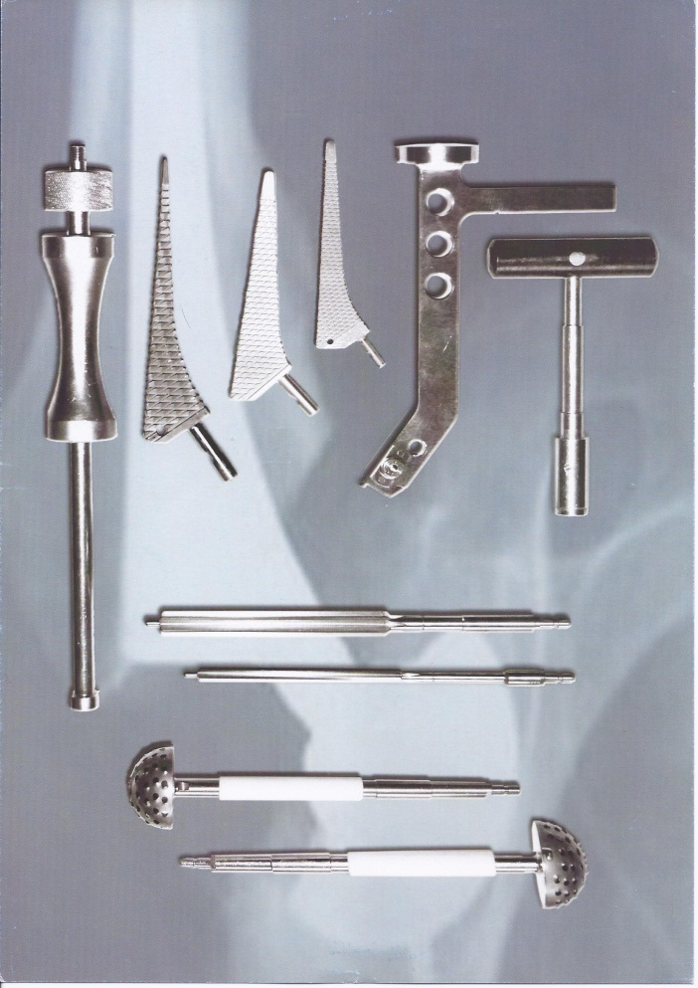

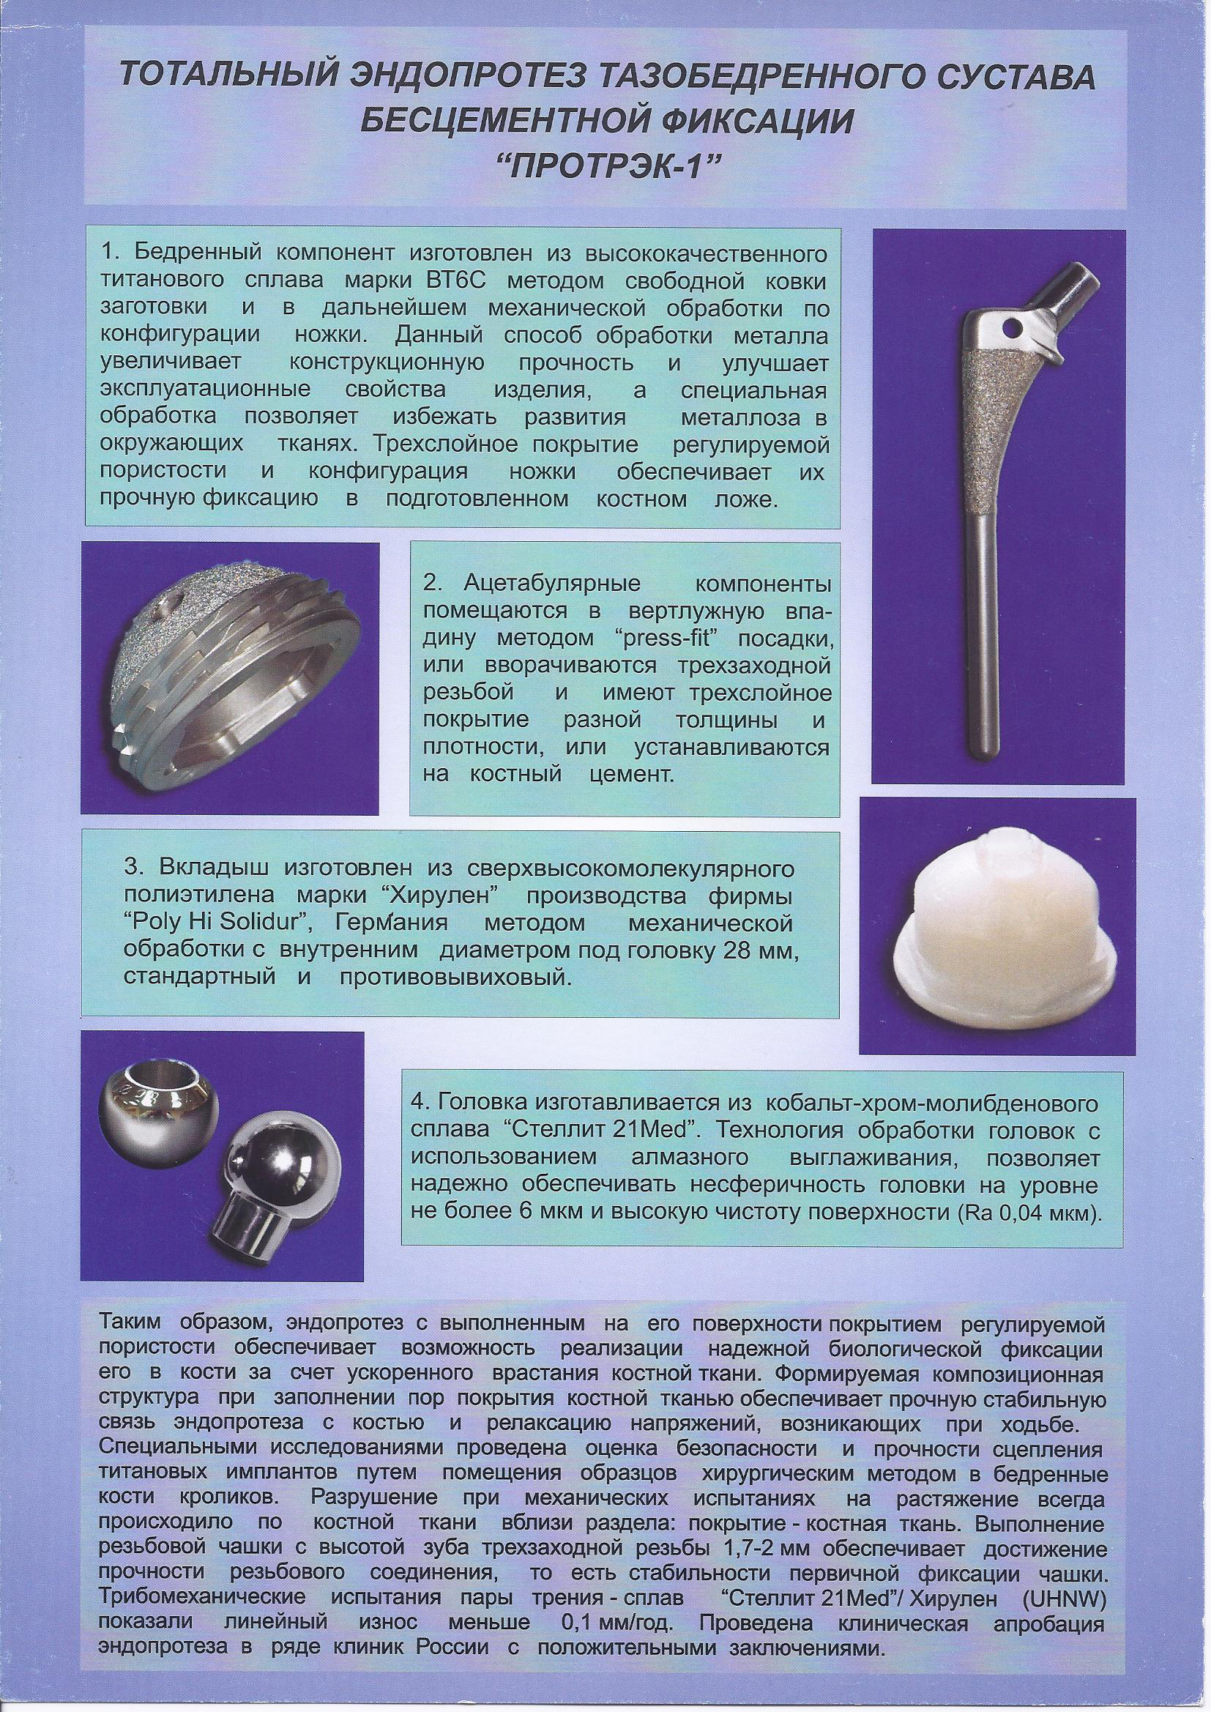

Development Examples
Medical products composition and technology development
Предприятия Минпромторга
Semimanufactured products
Enterprises of the Ministry of Industry and Trade of the Russian Federation
Medical instruments precision alloys rolling
Endoprosthesis Components
Medical institutions

Slide 7
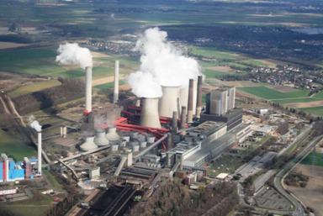
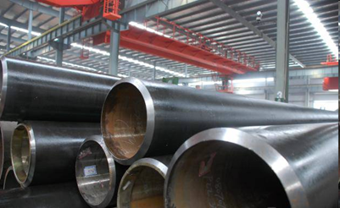
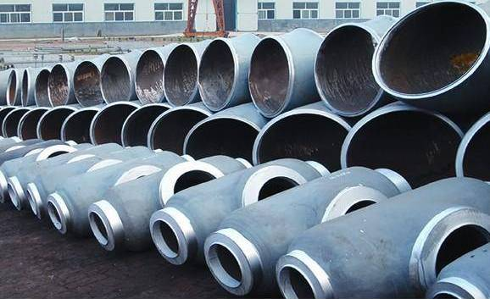
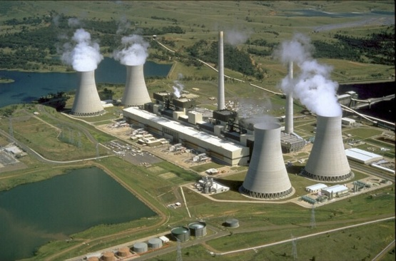
Development Examples
New generation heat-resistant steels development for Thermal Power Plants parts production
Properties (parameters) | Analogues (12Х1МФ) | Foreign analogues (14MoV6-3) | Expected
Ultimate strength σ_{в}, N/mm² | 410-600 | 490-640 | ≥600
Yield strength σ_{0,2}, N/mm² | 255-290 | 345 | ≥350
Impact strength КСV, J/cm2 KCU, J/cm2 | 12-15 49-59 | 41 - | ≥30 ≥120
Fracture toughness K_{IC}, MPA/m | 25-35 | 35-40 | ≥50
Work of crack propagation, J/cm2 | 10-15 | - | ≥30
Long-term strength, σ₁₀⁵ at 570⁰С, N/mm² | 80 | 93 | ≥110
Operating temperature, ⁰С | 570 | 570-585 | 600-700
Advantages of new technologies:
service life and safeness of constructions (equipment) made of new steels increases 1.5-2 times in comparison with existing marks;
reduce of contaminants and impurity of metal for non-metallic inclusions increases the quality of metal;
increase in long-term strength by 30% and operating temperature by 20-400⁰С;
labor costs reduction (by 12-15%), improvement of technological processes within production safety rise (including environmental)
30-40% increase of threshold stress intensity factor.
Capacity share of power plants
in the European part of Russia
16

Slide 8
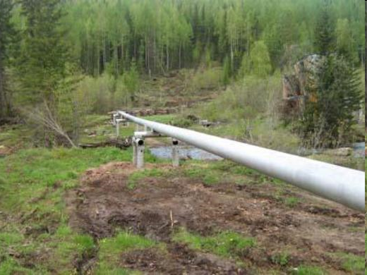
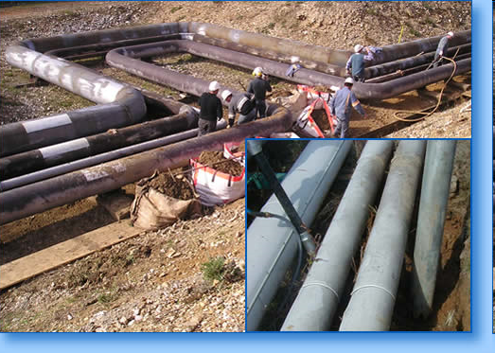
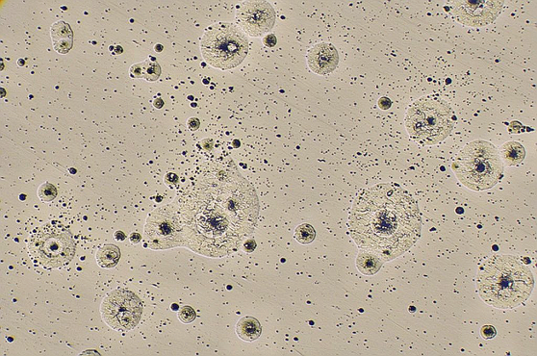

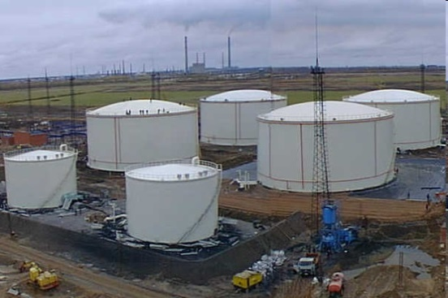
Заместителю генерального директора Ю.М. Коробко
Development Examples
New generation of cold temperature pipe steels with high resistance to local corrosion
Comparative characteristic
of developed steel and analogues
oilfield systems
oil field pipelines
heat system
Ways to achieve indicators:
Steelmaking technology development to ensure steel purity according to nonmetalic inclusions
heat system
steel impurity according to non-metalic inclusions
pure steel according to non-metalic inclusions
2. Optimization of the chemical composition of steel and technology for further processing to ensure high cold resistance, strength and other properties
oil tanks-separators
17

Slide 9
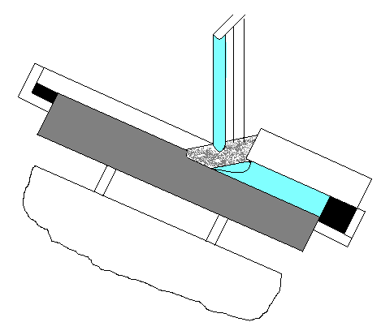
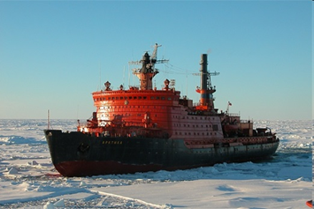
Development Examples
Double-layer steels for icebreaker class ships manufacturing
Fundamental scientific and technical novelty: | Advantages: Extremely high strength (> 450 N/mm2) and continuity (0-1 class according to ultrasonic testing) of the layer connection. Production costs reduce by 30-35%. Steel intensity reduction by 15-20% Alloying components reduce 2-4 times Production life index increase 2-3.5 times. Repair work volume decrease by 40-50% Good weldability
Unique electroslag surfacing technology use
18

Slide 10
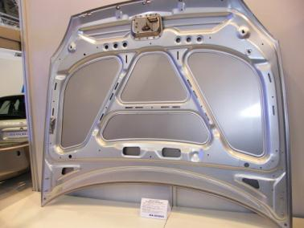
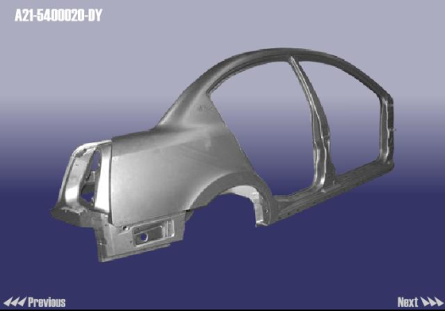
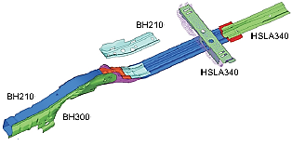
Development Examples
Development of mass high-quality sheet steels at Russian plants
Application area
Types of steel sheets for automobile industry in 2011 (more than 30 marks in total)
High stampable steels for cars front parts
Name of product | Steel mark
Cold rolled high-grade drawing from low carbon steel | 08Ю, DC04, DC05, DC06
Cold hot-galvanized roll stock from ultra-low carbon steels with BH-effect | HC180BD 006/IF-BH
Cold rolled ultra low carbon steel (IF-steel) | 01ЮТ 006/IF
Cold hot-galvanized roll stock from ultra-low carbon steels | 006/IF DX56D, DX57D
Cold-rolled microalloyed high-strength steels | HC300LA, HC340LA, HC380LA, HC420LA
Hot-rolled microalloyed high-strength steels | S500MC, S550MC S600MC 20ГЮТ
Cold hot galvanized roll stock from microalloyed high resistant steels | НХ260LAD, НХ300LAD НХ340LAD, НХ380LAD НХ420LAD
High strength steels for safety features and vehicle weight reduction
18

Slide 11
Development Examples
Perspective biphasic ferritic-martensitic steels
Main works of sheet steels for automobile industry today
Quality improvement and costs reduce for the production of steel marks mentioned above
Production of perspective biphase ferritic-martensitic steels of high strength class 780 and 980 in hot-galvanized and cold-rolled versions
Main advantages of high strength steels
- higher ductility (15% compared to baseline)
- more stable values of yield strength within the framework of one strength class (not more than 60-90 MPa instead of 80-150 MPa)
18

Slide 12
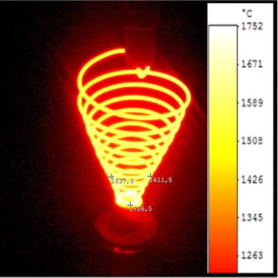
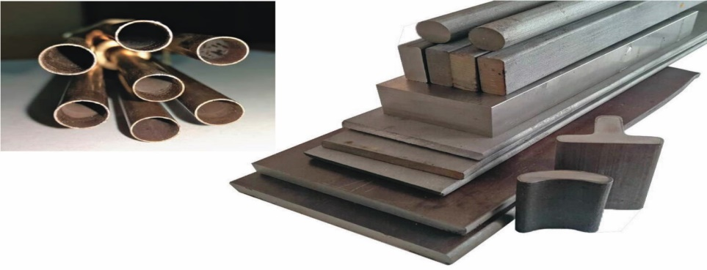
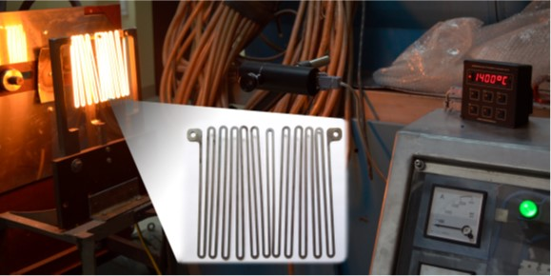
Development Examples
High-temperature resistant powder alloys and protective coatings of refractory metals for high-heat-stressed structures with a long-term operating time in oxidizing environmental temperatures up to T = 1400 ... 1700 ° С
Tungsten wire Ø4 mm with diffusion silicide coating WSi2,
total operating time at Т = 1600 ... 1700 ° С - more than 75 hours in the air
Samples of high heat resistant alloy powder products
Powder alloy electric heater 0.8 mm thick, total operating time at Т = 1400 ° С - more than 100 hours in the air

Slide 13
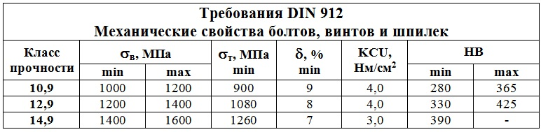
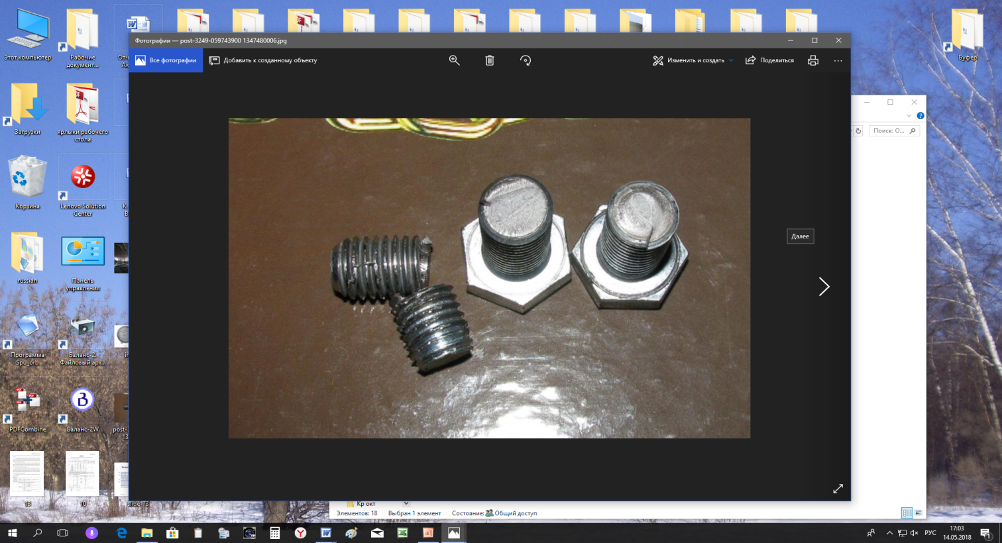
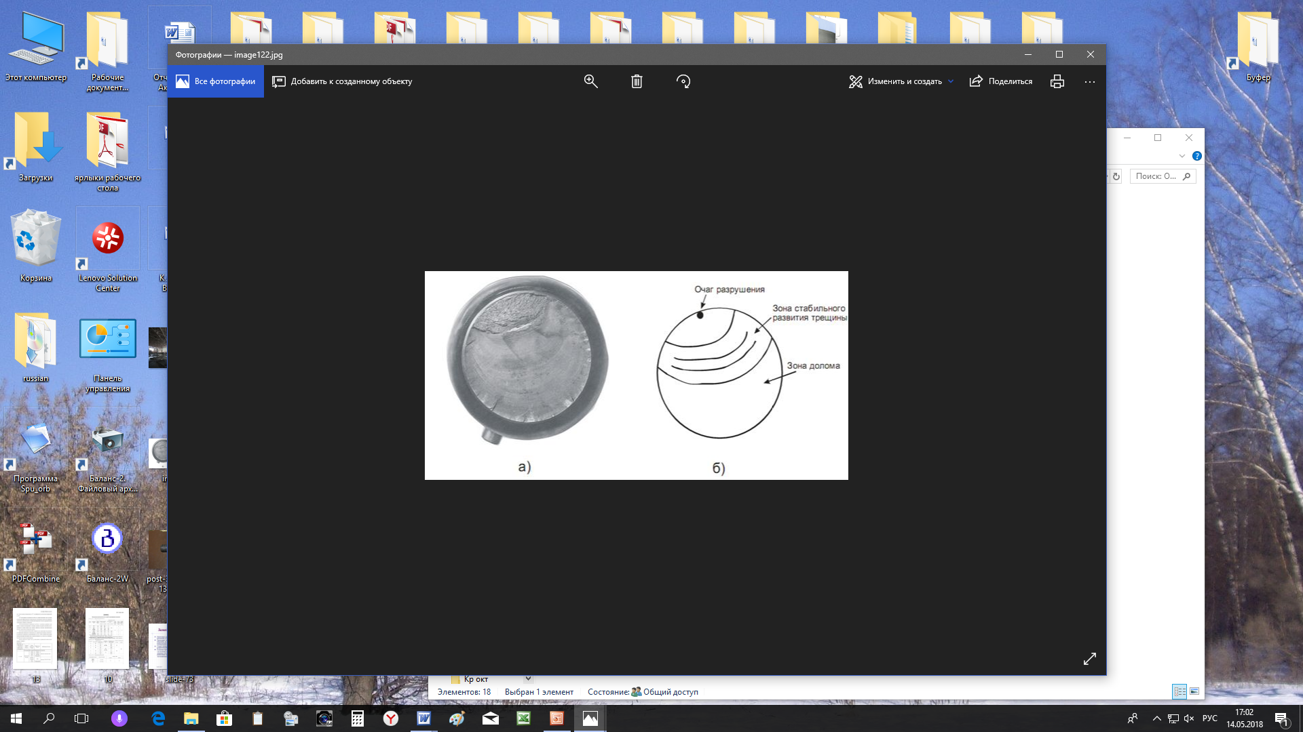
Development Examples
Steel and high-strength fasteners production technology
with increased resistance to delayed brittle fracture
Steels for fasteners of strength class 10.9 - 14.9 with high level of consumer properties provide:
combination of high strength, ductility, impact strength and crack resistance. At strength class 14.9 (σ_{в} = 1400-1600 MPa) the following indexes are higher: impact strength - 15% (KCU-60 = 45 J/cm2);
crack resistance - 20%, elongation - 1.5 times (12%);
increased resistance to delayed brittle fracture - 1.5 times; increased resistance to corrosion in a slightly aggressive industrial environment - 15-20%.
20

Slide 14
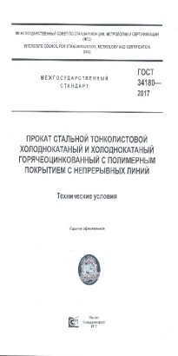
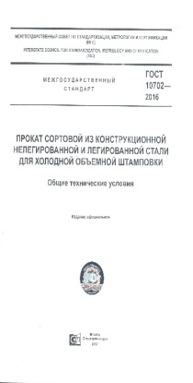
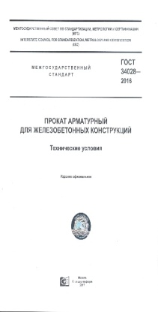
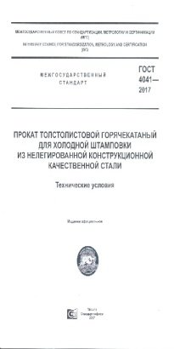
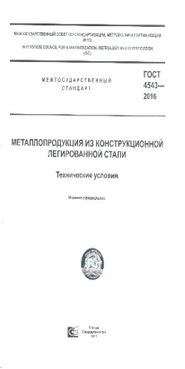
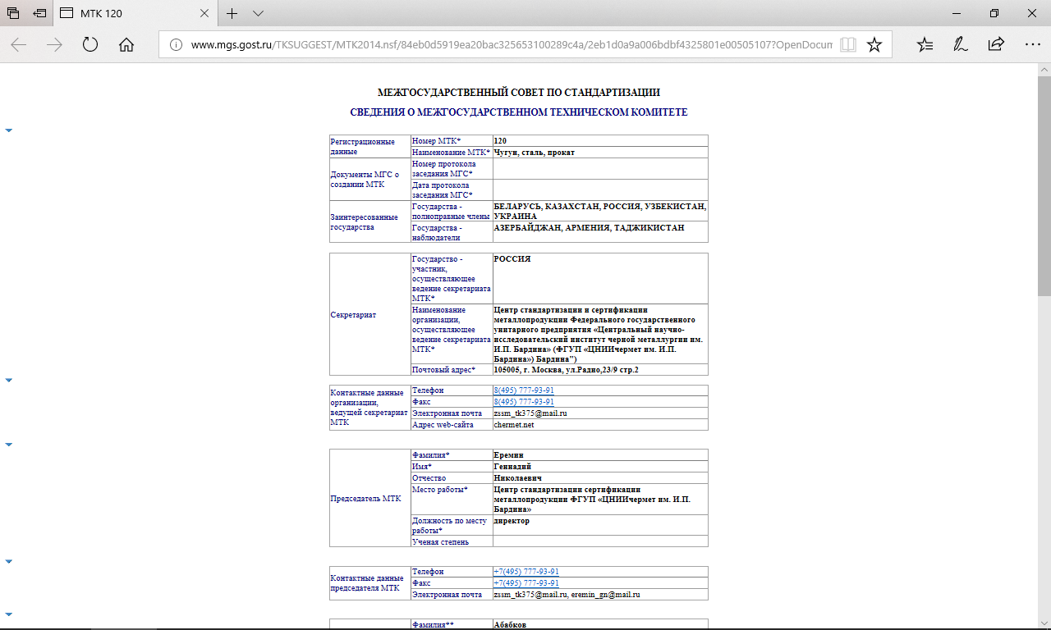
Two Technical Committees operate in the FSUE I.P. Bardin Central Research Institute for Ferrous Metallurgy:
National Technical Committee TC 375 “Metal production from ferrous metals and alloys”,
Interstate Technical Committee MTC 120 “Cast Iron, Steel, Rolled Steel”
TC 375 is a full member of Technical Committees of the International Organization for Standardization ISO - TС 17 "Steel" and TС 119 "Powder Metallurgy". With the participation of TC 375 there were developed 11 international standards for metal products. Technical Committee 375 and International Technical Committee 120 cooperate actively with foreign technical committees, including TC "Steel", DIN, CEN / CENELEC.
TC 375 is a co-developer of steel grade guide Stahlschlussel.
By the order of the Ministry of Industry and Trade of the Russian Federation dated 24.04.2019 No. 1474 State Scientific Center FSUE I.P. Bardin Central Research Institute for Ferrous Metallurgy became the head organization for standardization of defense production in metal sector.
14

Slide 15
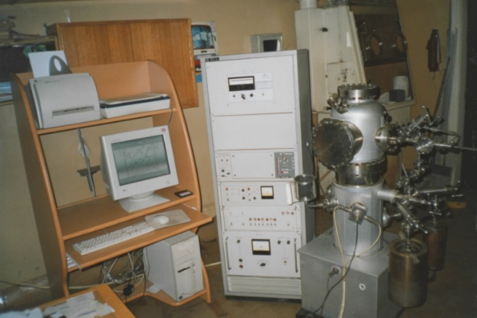
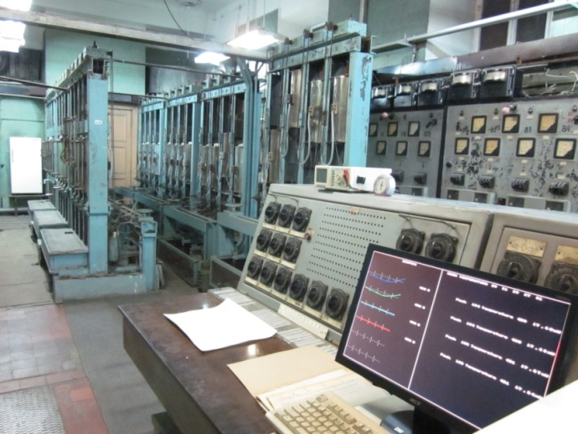
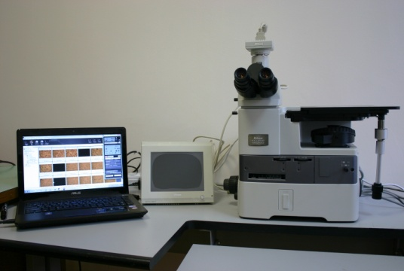
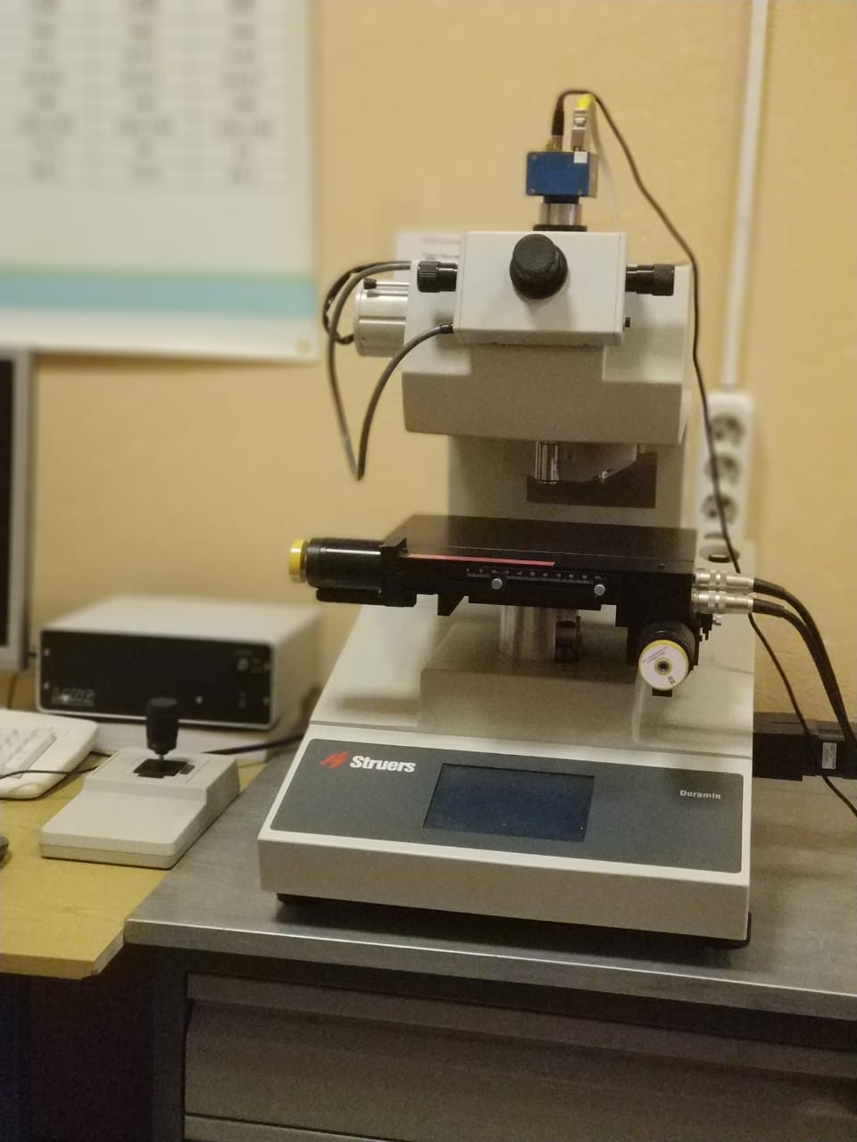
Tests of metal products in the State Scientific Center
FSUE I.P. Bardin Central Research Institute for Ferrous Metallurgy
The advantage of the State Scientific Center FSUE I.P. Bardin Central Research Institute for Ferrous Metallurgy is a variety of domestic and foreign equipment (attorney and/or certified) that consists of main and auxiliary equipment with software, automated measuring complex analyzing the sample (or material) by different methods that allow on the basis of researches and results take the right decision.
Notes:
15

